Slide 1
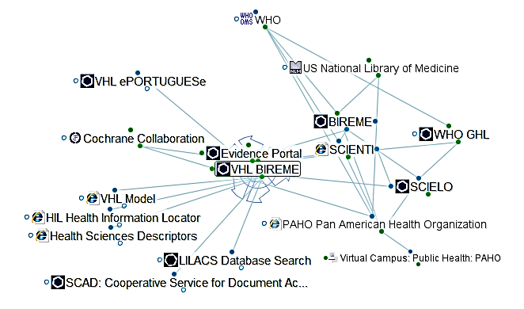
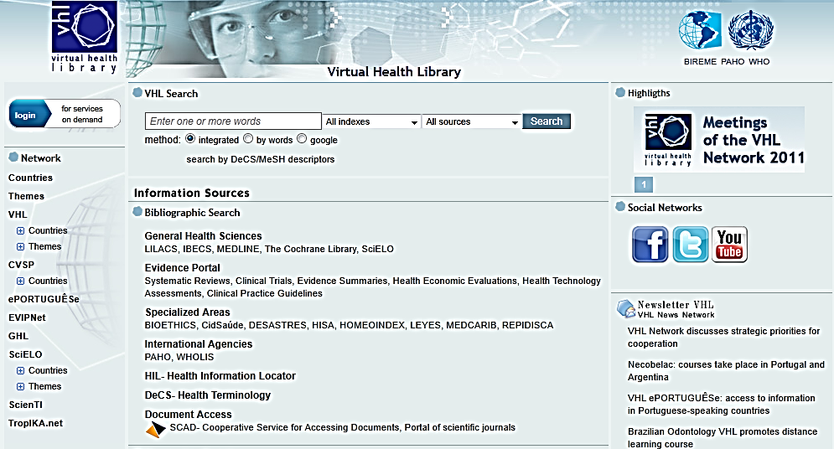
Virtual Health Information Infrastructures: Scale and Scope
Ann Séror, MBA, PhD¹
¹eResearch Collaboratory, Quebec City, QC, Canada, Url: http://eresearchcollaboratory.blogspot.com/, Email: annseror@eresearchcollaboratory.com
Introduction
This research program examines scale and scope in design of virtual infrastructures for the regional Virtual Health Library of the Latin American and Caribbean Health Sciences System (BIREME) with particular focus on the Virtual Campus for Public Health (VCPH). Virtual infrastructures refer to an environment characterized by overlapping distribution networks accessible through Internet portals and websites designed to facilitate integrated use of available resources. Case analysis shows engagement of interdisciplinary communities of practice for scalable virtual infrastructure design and social media integration. This program of study considers transferability of the Latin American model to large health care systems in other cultures such as India and China.
Methods
The regional infrastructures of the Latin American and Caribbean Health Sciences System (BIREME) offer a rich context including the multi-level configuration of regional and national system levels. This choice of case offers examination of the reciprocal roles of regional and country level leadership in health information system development While this study may not yield generalizable conclusions, it suggests the critical coevolution of regional and national knowledge ecologies and the ideological role of the social medicine model shared among countries of the Latin American region. Data are drawn from published accounts of system development and the websites of the constituent organizations, networks and services to describe the configuration of virtual infrastructures. The mapping methodology reveals diverse infrastructural patterns of health care information system management and control. E-mapping software is used to visualize an extended map of the linkages among resources identified in the knowledge ecology. The map generated using this methodology shows how global, regional and national resources are shared and integrated in the virtual infrastructure. (Figure 1 shows a screenshot of the map of Bireme. The map database is available online for review.)
Results
The Latin American and Caribbean Health Sciences System was founded in 1967 with the mission to promote national capacities to create and provide open access to technical and scientific information in medicine and public health. The current Virtual Health Library (VHL) is a distributed database using open source software - designed to be fully accessible on the Internet and compatible with international standards. National VHL systems are in development across Latin America with increasing participation of European (Spain and Portugal) as well as African countries The VHL information networks link reference databases, specialist directories, health care institutions, a catalogue of information resources available on the Internet, collections of full text scientific journals, and virtual communities. The system is primarily dedicated to presentation of information in Spanish and Portuguese, but policies are being developed in some sectors to include English and French. Free access to social media including Facebook, Twitter and YouTube add a new layer of infrastructure brokering information among networked institutions and individuals. As the Virtual Library has grown, the design of the system has focused increasingly on interactive features– extending the scope of integration to education and training. In 2003, the Pan American Health Organization (PAHO) launched the regional Virtual Campus for Public Health (VCPH) in collaboration with academic institutions of Latin America and Spain. The mission of the VCPH is to contribute to continuing education and policy making in public health throughout Latin America and the Caribbean. This virtual space offers a collaborative environment with tools for creation and sharing content as well as development and reuse of resources. Users are invited, for example, to create learning objects and to develop and share such objects through the learning network. Locally generated contributions published in Spanish and Portuguese address pertinent preoccupations such as traditional medical practice. The regional system website offers access to a guide for implementation of the Virtual Health Library, shared methodologies for scientific publications, and open source tools for system development at the country level. Search tools make national VHL resources and publications accessible through the regional VHL Portal shown in Figure 2.
Discussion and Conclusions
Effective system integration from the country level to the regional scale is founded on the values of the Latin American social medicine model where communities of practice share common ideologies associated with universal access to health care services, public education in medicine and the health sciences, and open access to health information and research. Shared cultural values and language are critical to scalability of the VHL from local and national levels to regional and global systems. Analysis of these regional virtual infrastructures suggests that the founding commitments to the Latin American ideological tradition of social medicine have shaped development of BIREME and made possible the effective integration of country level health information networks at the regional level of analysis. The Bireme network has also extended the scope of its activities to include education and training in public health and medicine. This collaborative process is facilitated by the ideology of open source software development and open access to health information and research- fostering interdisciplinary communities of practice where physicians and scientists may participate directly in design and construction of the infrastructures serving their activities. Transferability of this system design depends on shared values and ideology as well as other dimensions of social diversity including language and literacy.
References: Bireme Website at http://regional.bvsalud.org/php/index.php?lang=en
Bireme Map Database : http://webbrain.com/brainpage/brain/0673AB99-E205-2FB2-2976-47144CC20F25/#-14
Virtual Campus for Public Health (VCPH) Portal : http://portal.campusvirtualsp.org/virtualcampus/drupal/index.php?q=en
Figure 1. Map of Bireme
Figure 2. Virtual Health Library (VHL) Portal (Accessed 10-8-2011)

